Slide 1
STATE MANAGEMENT ASP.NET CORE
UMESH MAREBOINA

Slide 2
What is State Management
As we all know, browsers are generally stateless.
Stateless means, whenever we visit a website, our browser communicates with the respective server depending on our requested functionality or the request. The browser communicates with the respective server using the HTTP or HTTPs protocol.
it doesn't hold the state of a previous website that we visited before closing our browser, that is called stateless.

Slide 3
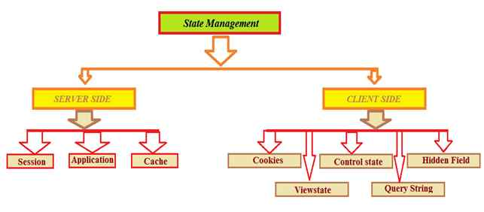
State Management Techniques

Slide 4
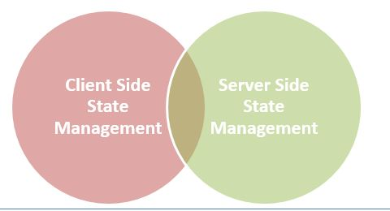
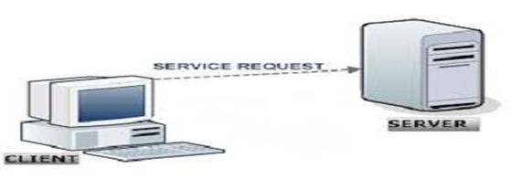
State Management Types
In ASP.NET there are the following 2 State Management methodologies:
Client-Side State Management
Server-Side State Management
Client-Side State Management
Whenever we use Client-Side State Management, the state related information will directly get stored on the client-side. That specific information will travel back and communicate with every request generated by the user then afterwards provides responses after server-side communication.

Slide 5
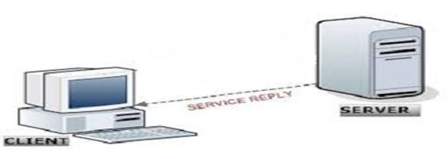
Server-Side State Management
Server-Side State Management is different from Client-Side State Management but the operations and working is somewhat the same in functionality. In Server-Side State Management all the information is stored in the user memory. Due to this functionality there is more secure domains at the server side in comparison to Client-Side State Management.

Slide 6
Server-Side Technique
Session Event Session event can be seen in project Global.asax file. Two types of Session Events Session Start The Session start event is raised every time a new user requests without a session ID.
void Session Start(object sender, EventArgs e)
{
Session["master"] = "~/Master.master";
}
Session_End The Session_End event is raised when session is ended by a user or a time out using Session end method.
void Session_End(object sender, EventArgs e)
{
Response.Write("Session_End");
}
Session
Session is a very important technique to maintain state. Normally session is used to store information and identity. The server stores information using Session id. Set User Session
protected void btnSubmit_Click(object sender, EventArgs e)
{
Session["UserName"] = txtName.Text;
Response.Redirect("Home.aspx");
}

Slide 7
Application
Application State is a server side management state. It is also called application level state management. In this mainly store user activity in server memory and application event shown in Global.asax file.
Their are three types of applications in ASP.NET. Application_Start This event begins with domain start.
Void Application_Start(object sender, EventArgs e)
{
Application["AppstartMessage"] = "Welcome to CSharp Corner Developer Communtiy";
}
Application_Error In this section manage unhandled exception error.
void Application_Error(object sender, EventArgs e)
{
// Write an unhandled error code exception
}
Application_ End This ends with domain or restarts IIS.
Void Application_End(object sender, EventArgs e)
{
Application["AppEndMessage"] = "Application Closed";
}
Cache Cache is stored on server side. It implements Page Caching and data caching. Cache is use to set expiration polices Response.Cache.SetExpiresTime(DateTime.Now.AddDays(1));

Slide 8
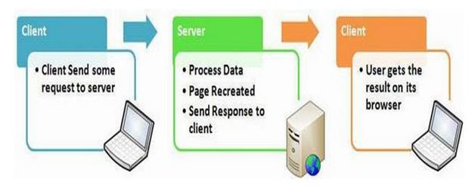
Client-Side State Management techniques are,
View State
Hidden field
Cookies
Control State
Query Strings
View State
This property is enabled by default but we can make changes depending on our functionality, what we need to do is just change the EnableViewState value to either TRUE for enabling it or FALSE for the opposite operation.
Some of the features of view state are:
It is page-level State Management
Used for holding data temporarily
Can store any type of data
Property dependent

Slide 9
Hidden Field
A hidden field is used for storing small amounts of data on the client side. In most simple words it's just a container of some objects but their result is not rendered on our web browser. It is invisible in the browser.
It stores a value for the single variable and it is the preferable way when a variable's value is changed frequently but we don't need to keep track of that every time in our application or web program.
// Hidden Field
int newVal = Convert.ToInt32(HiddenField1.Value) + 1;
HiddenField1.Value = newVal.ToString();
Label2.Text = HiddenField1.Value;
Some features of hidden fields are:
Contains a small amount of memory
Direct functionality access

Slide 10
Persistent Cookie
Cookies having an expiration date is called a persistent cookie. This type of cookie reaches their end as their expiration dates comes to an end. In this cookie we set an expiration date.
Non-Persistent Cookie
Non-persistent types of cookies aren't stored in the client's hard drive permanently. It maintains user information as long as the user access or uses the services. Its simply the opposite procedure of a persistent cookie.
Some features of cookies are:
Store information temporarily
It's just a simple small sized text file
Can be changed depending on requirements
User Preferred
Requires only a few bytes or KBs of space for creating cookies
Cookies
A set of Cookies is a small text file that is stored in the user's hard drive using the client's browser. Cookies are just used for the sake of the user's identity matching as it only stores information such as sessions id's, some frequent navigation or post-back request objects.
Whenever we get connected to the internet for accessing a specific service, the cookie file is accessed from our hard drive via our browser for identifying the user. The cookie access depends upon the life cycle or expiration of that specific cookie file.
Two Types of Cookies:

Slide 11
Control State
Control state is based on the custom control option. For expected results from CONTROL STATE we need to enable the property of view state. As I already described you can manually change those settings.
Some features of query strings are:
Used for enabling the View State Property
Defines a custom view
View State property declaration
Can't be modified
Accessed directly or disabled

Slide 12
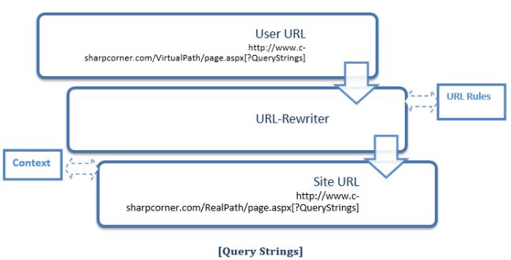
Query Strings
Query strings are used for some specific purpose. These in a general case are used for holding some value from a different page and move these values to the different page. The information stored in it can be easily navigated to one page to another or to the same page as well.
Some of the features are,
It is generally used for holding values
Works temporarily
Switches info from one to another page
Increase performance
Uses real and virtual path values for URL routing

Slide 13
THANK YOU..!!
UMESH MAREBOINA

